Slide 1
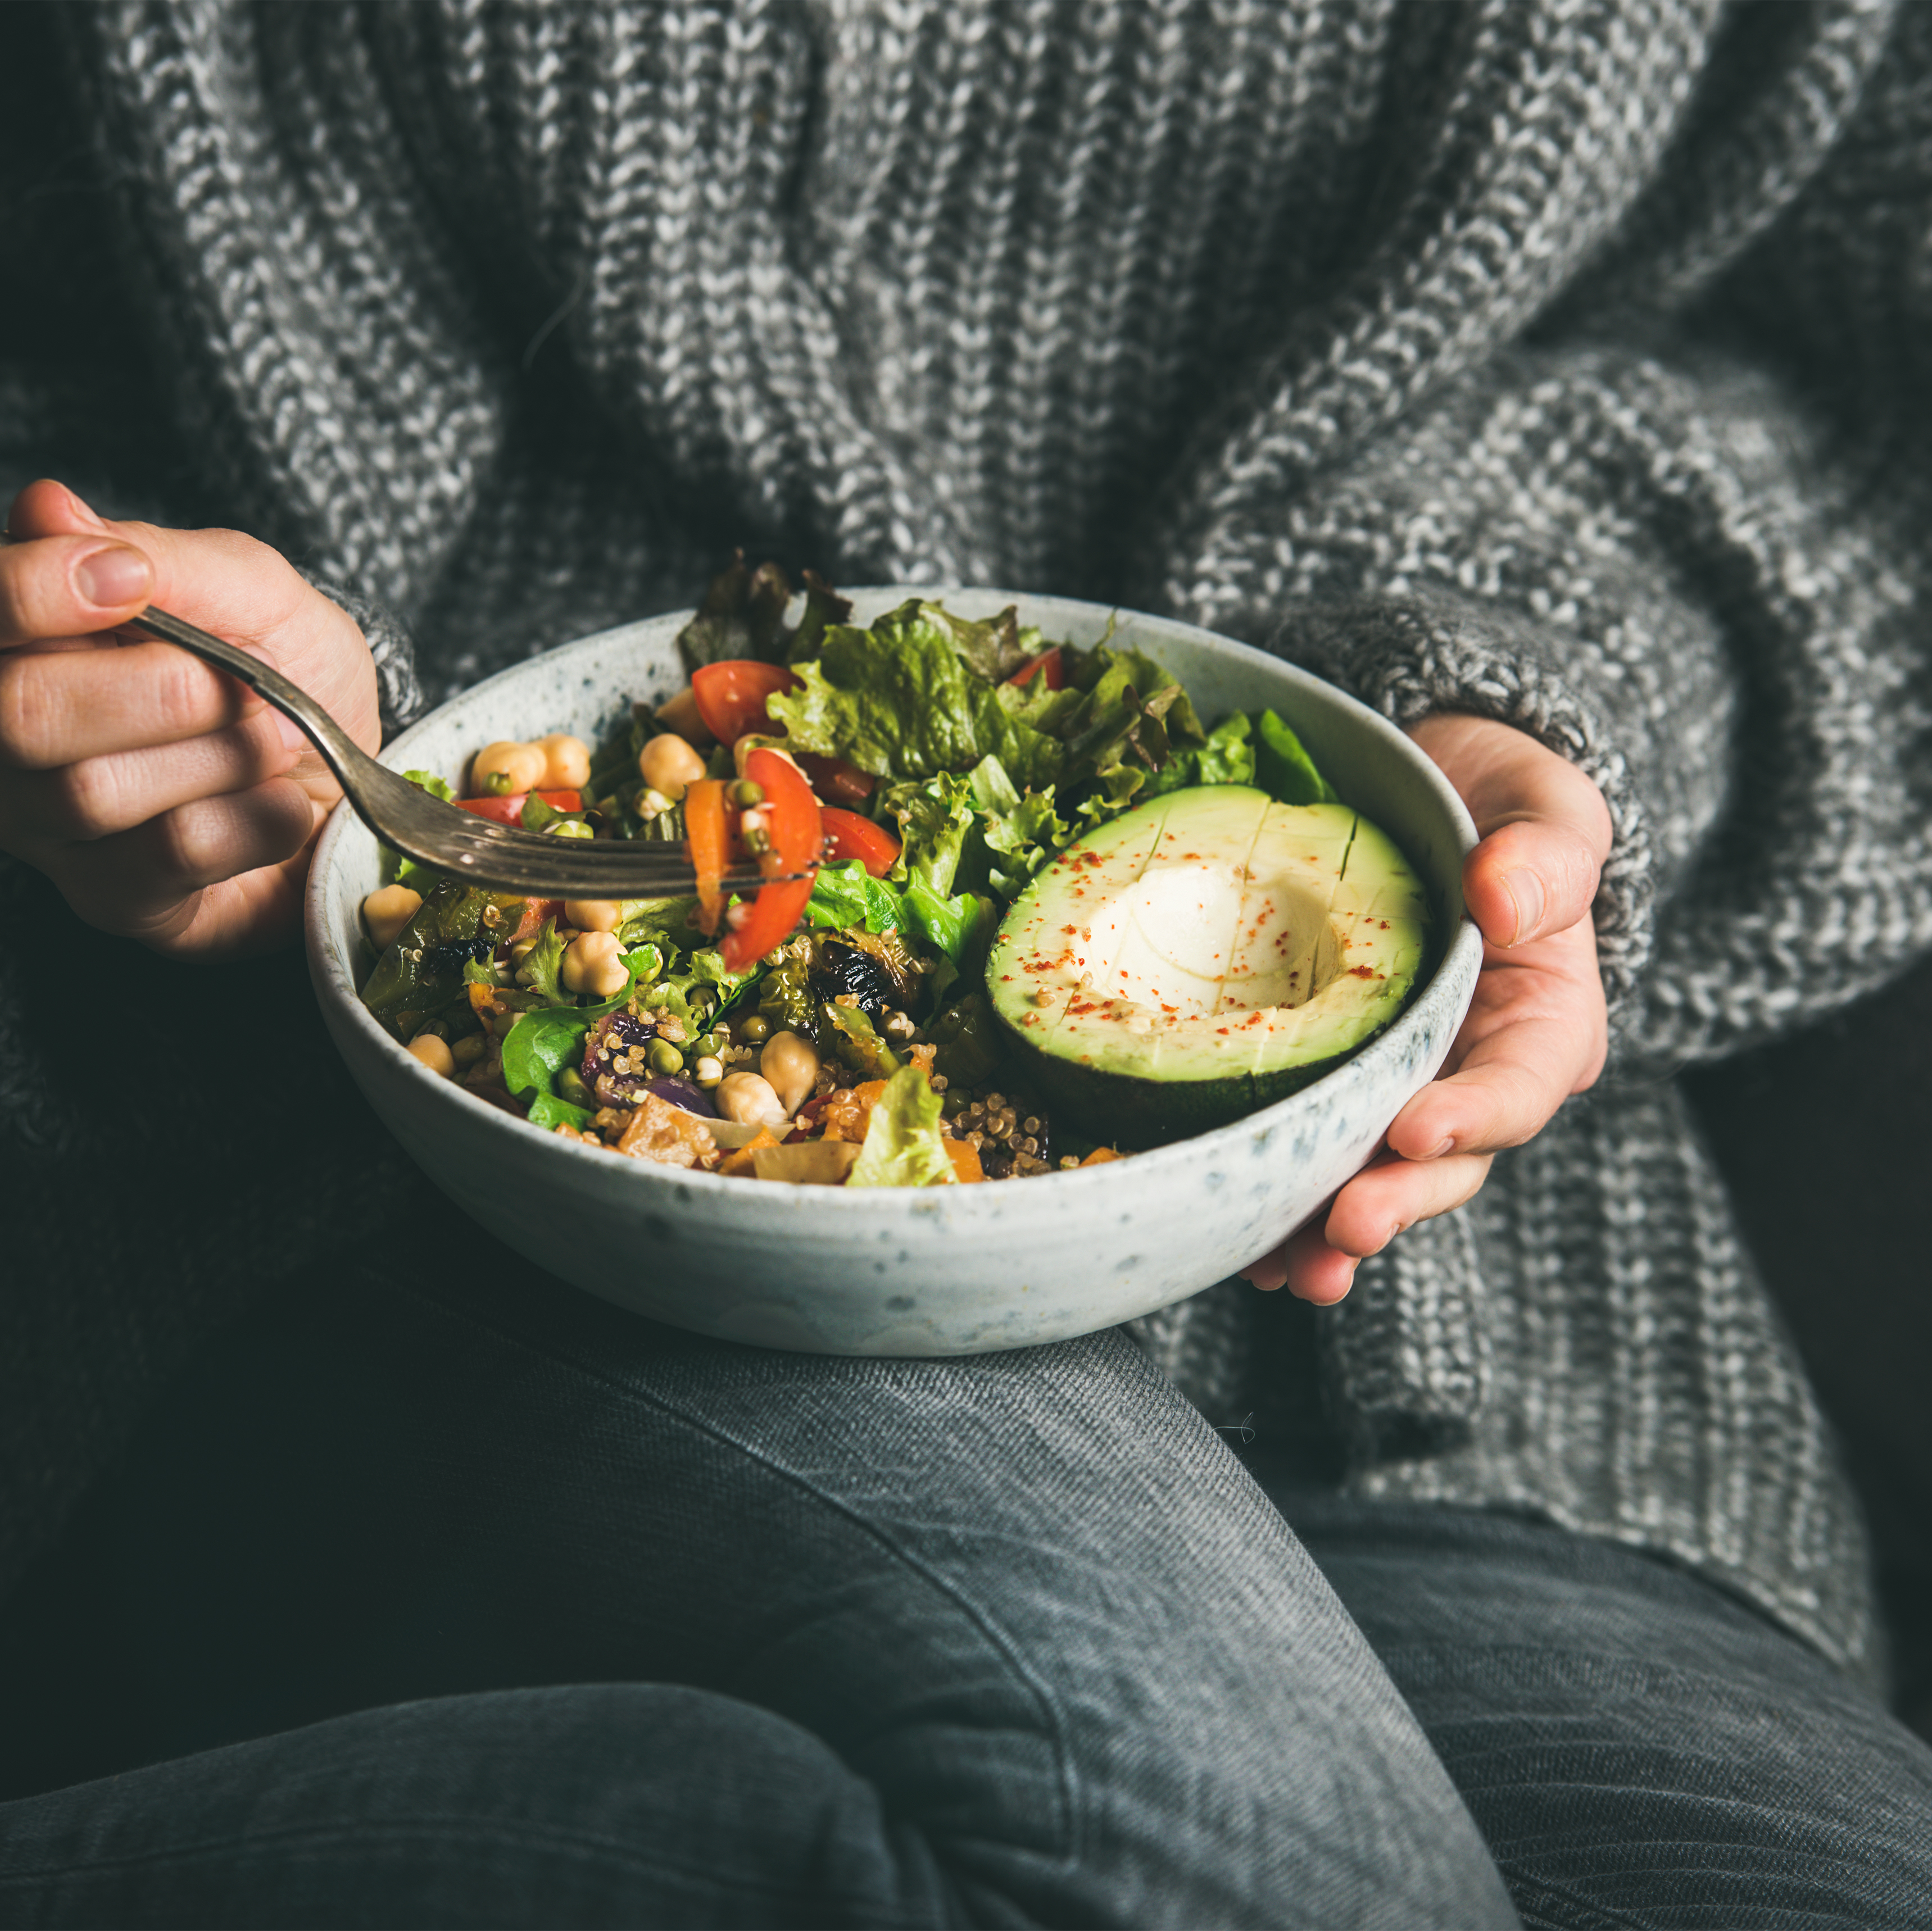
Healthawy
Graduation Project
2023-2024

Slide 2
Working Team
Name:
Ali Ahmed Selim
John Tamer Albert
Ahmed Khaled Mohamed
John George
Mahmoud Mohamed Gabr
Mohaned Fouad
Mohamed Eid
ID:
20-00803
20-00254
20-00019
20-01099
20-00266
20-00288
20-00472
Supervied By
Dr. Khaled Fathy
Eng. Farida Gaber

Slide 3
Abstract
For many reasons we made this website for health awareness. A nutrition website can help users become more aware of their dietary habits and make healthier food choices. It can provide information about the nutritional content of different foods, helping users make informed decisions about their diet.

Slide 4
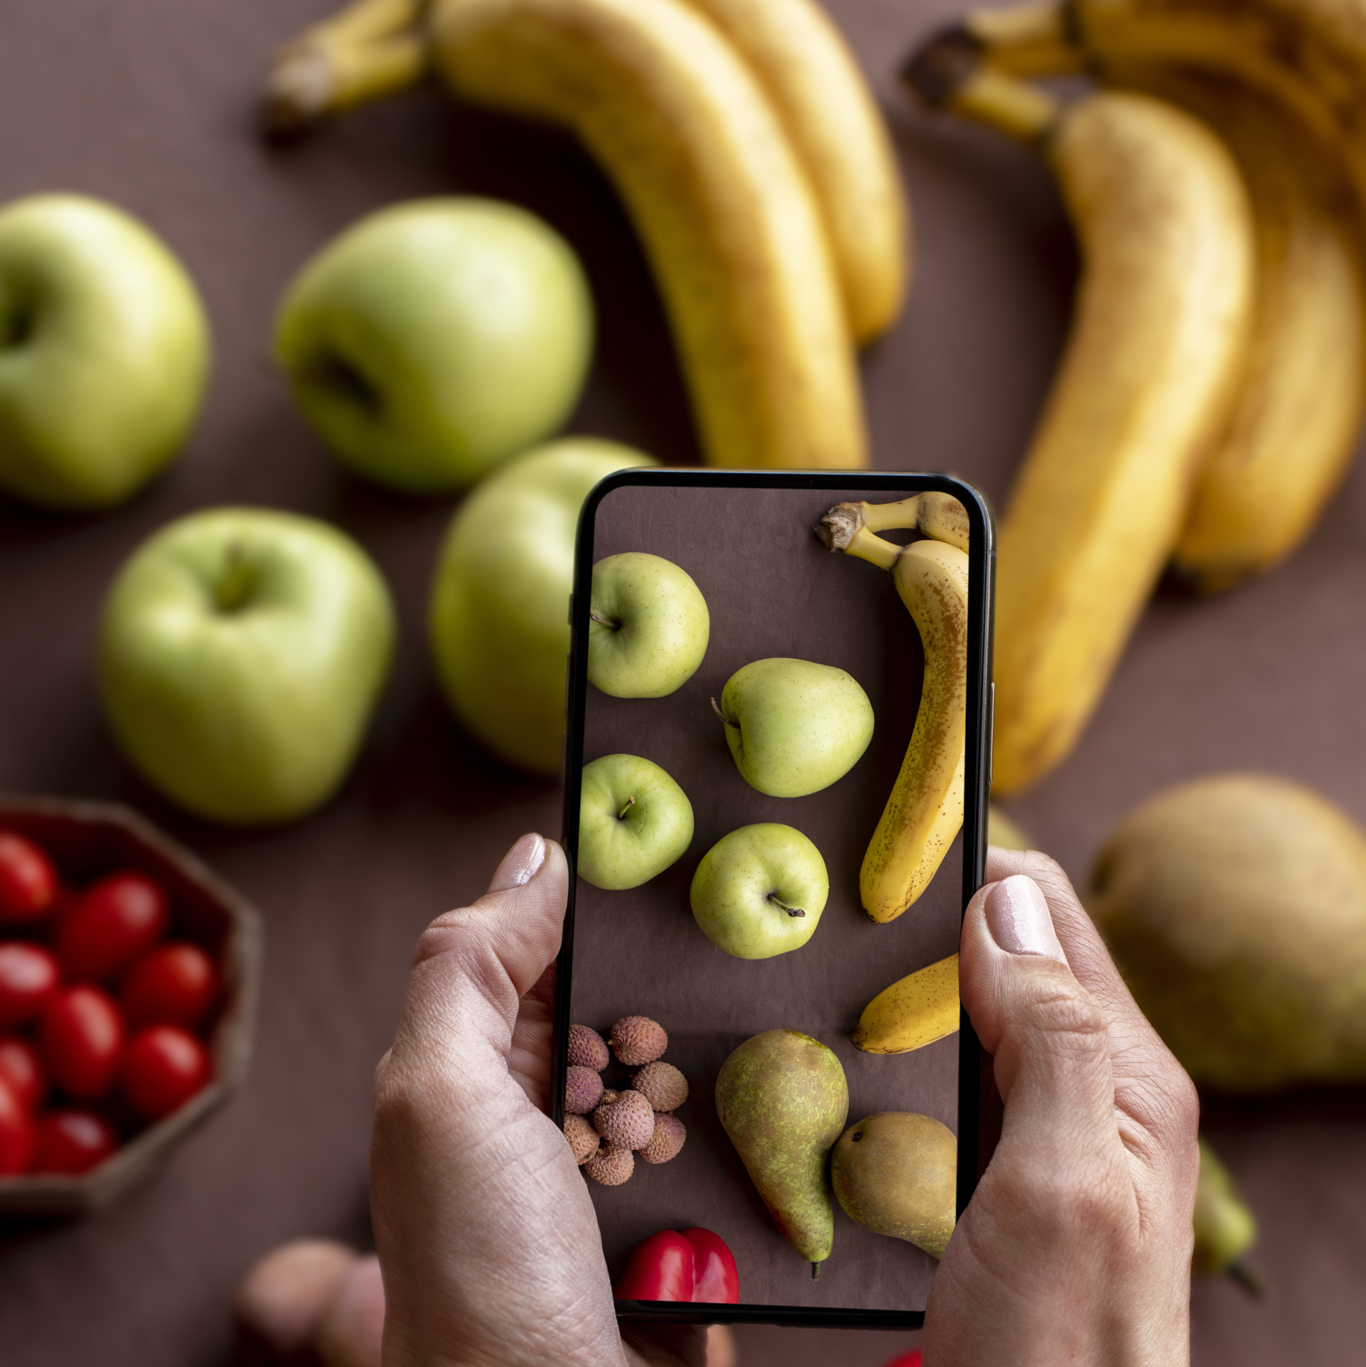
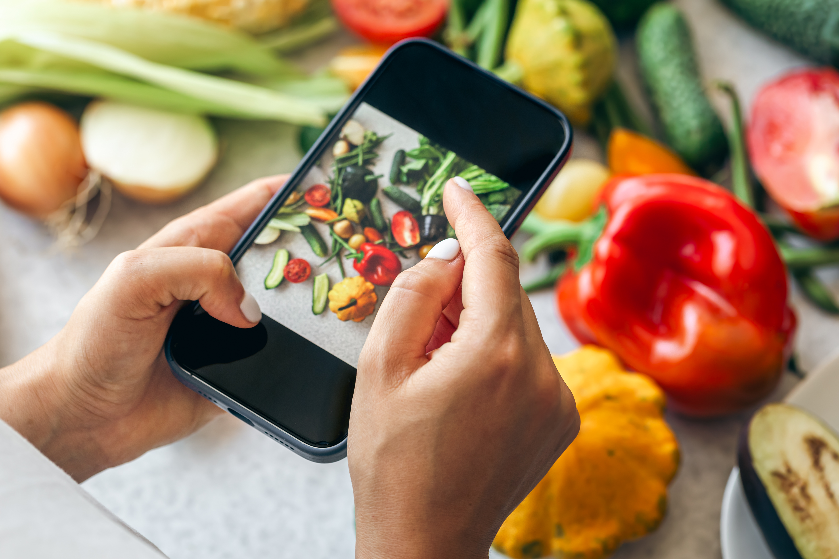
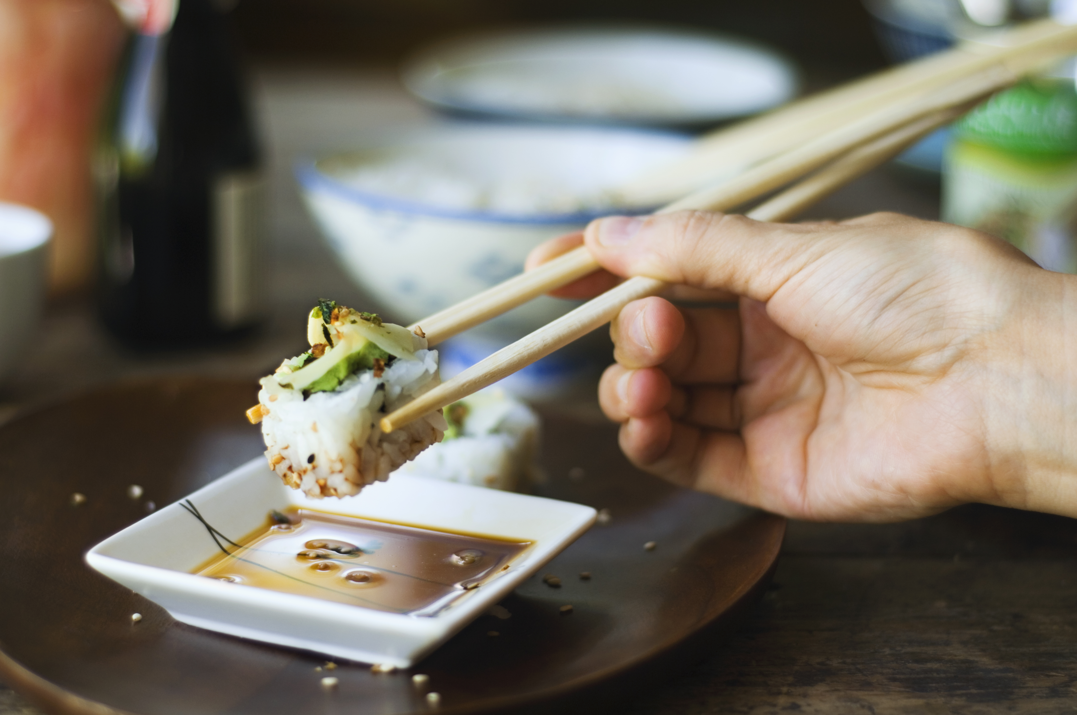
Agenda
Introduction
Problem Statement
Similar applications
Research Objectives
System Design
Methodology
Datasets
Deep Learning
Testing and Maintenance
Demo
Conclusion
Future Work
References

Slide 5
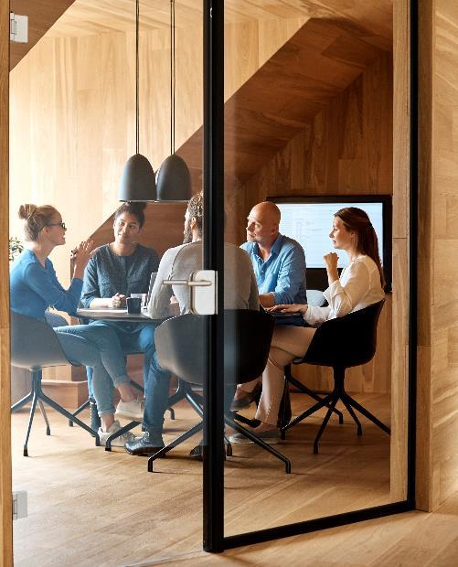



Introduction
Welcome to Helthawy, your ultimate destination for personalized recipes tailored to your health needs.
Join us on a journey towards better health and culinary satisfaction with Helthawy.

Slide 6

Problem Statement
Existing nutrition tools fall short in providing a precise, user-friendly solution for individuals to manage both calories and essential vitamins. Our Food Nutrition Application aims to fill this gap, offering a holistic approach to personalized dietary tracking for optimal health.

Slide 7




Similar applications
Other applications
MyFitnessPal
Calorie tracking “track daily calorie intake and set personalized goals”
Nutritional guidance “access to nutritional information and personalized recommendations “
Exercise tracking “log and track various physical activities for fitness monitoring”
Lifesum
Calorie tracking “monitor calorie intake and set daily targets ”
Meal planning “plan and prepare meals based on dietary preferences and goals ”
Exercise integration “integrate exercise date and track physical activities for bettes health management”
Noom
Calorie tracking “log food intake and receive color-coded feedback for better food choics”
Meal planning “access to personalized meal plans and recipes for effective weight management “
Community support “connect with a virtual support group and receive coaching for motivation”

Slide 8
Research Objectives
The system provides the user with their optimal caloric intake depending on the data they input in the system using our calculations
Users can input their ingredients and calculate their caloric intake
Include features like portion sizes, customizable meal templates.
helps them find the nutritional values of the items they use in their meal or the meal itself by looking it up manually using the database we have provided on the system of the ingredients and their nutritional values.
include details such as calories, macronutrients (protein, carbohydrates, water)
Implement a machine learning (ML) model capable of identifying ingredients from user-uploaded images.
When users take a picture of their ingredients, the ML model analyzes the image and identifies each item.

Slide 9
System Design
We used 3 designs to describe our system and explain it and there are :
Sequence diagram
Class diagram
Use case diagram

Slide 10
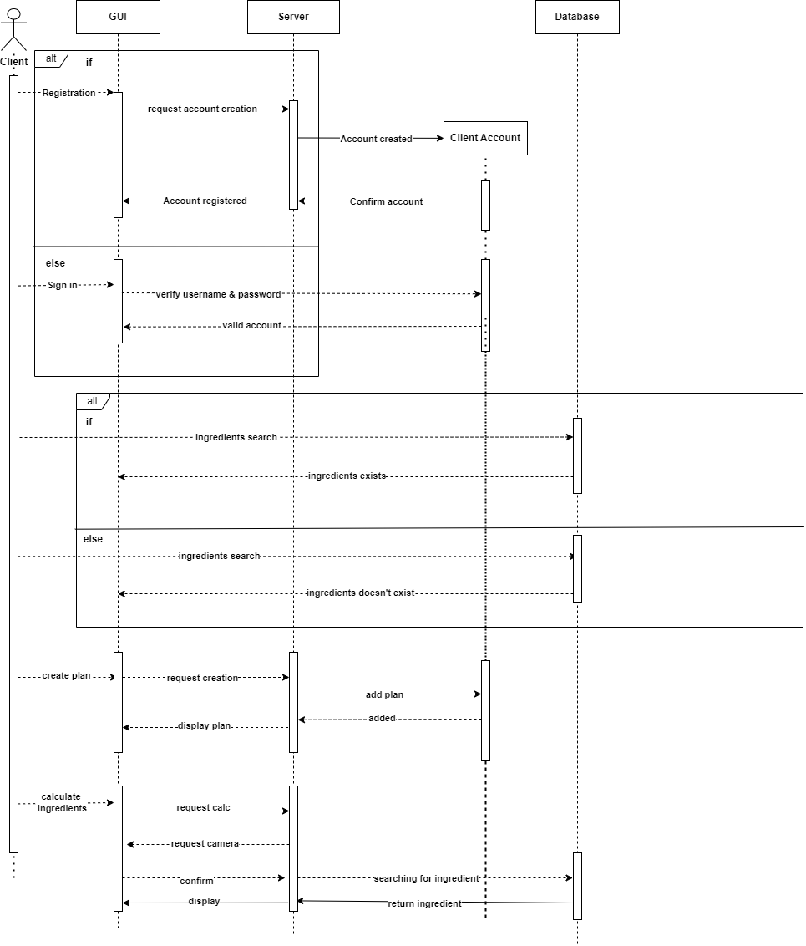
Sequence diagram :

Slide 11
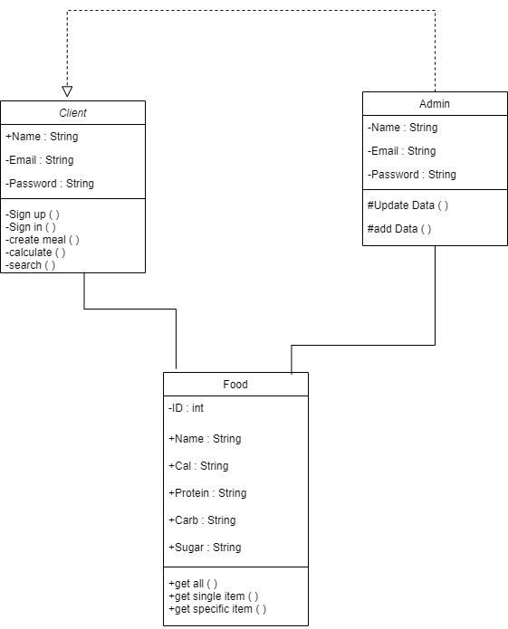
Class diagram :

Slide 12
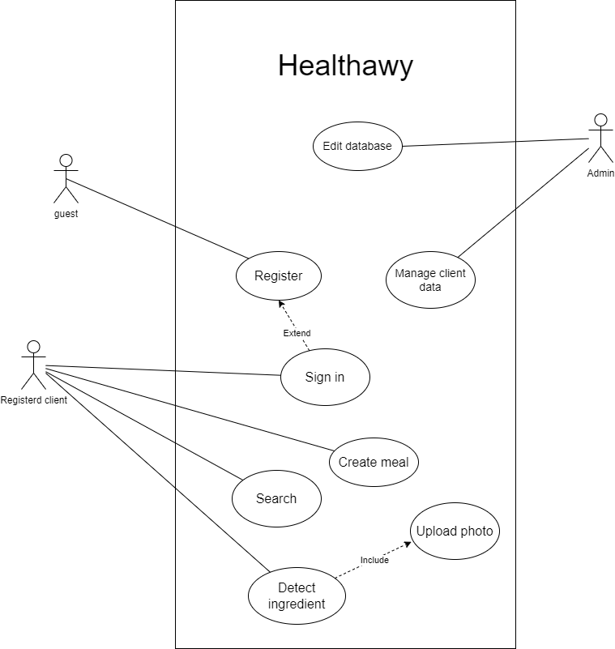
Use case diagram :

Slide 13
Methodology of Proposed Approach
Front end:
• HTML: Structures the web pages, including sections for user profiles, nutritional articles, meal plans, and feedback forms.
• CSS: Styles the website with a consistent theme, ensuring that it is visually appealing and easy to navigate on all devices.
• JavaScript: Adds interactivity, such as validating user input on dietary assessment forms, fetching and displaying nutritional data from external APIs, and creating interactive charts to visualize user progress.
• React JS: Manages complex UI components, state, and data flow, enabling features like personalized meal plans, user dashboards, and real-time updates of nutritional information.
Backend :
We used node js as a server side with no sql databases using Yolo v5 and pytorch for the AI and Machine learning
Source of data : multiple datasets form Kaggle and roboflow
Used algorithm in machine learning:
model Yolo v5 because it is easy to do transfer learning with over multiple datasets to improve the model in every iteration with high accuracy

Slide 14
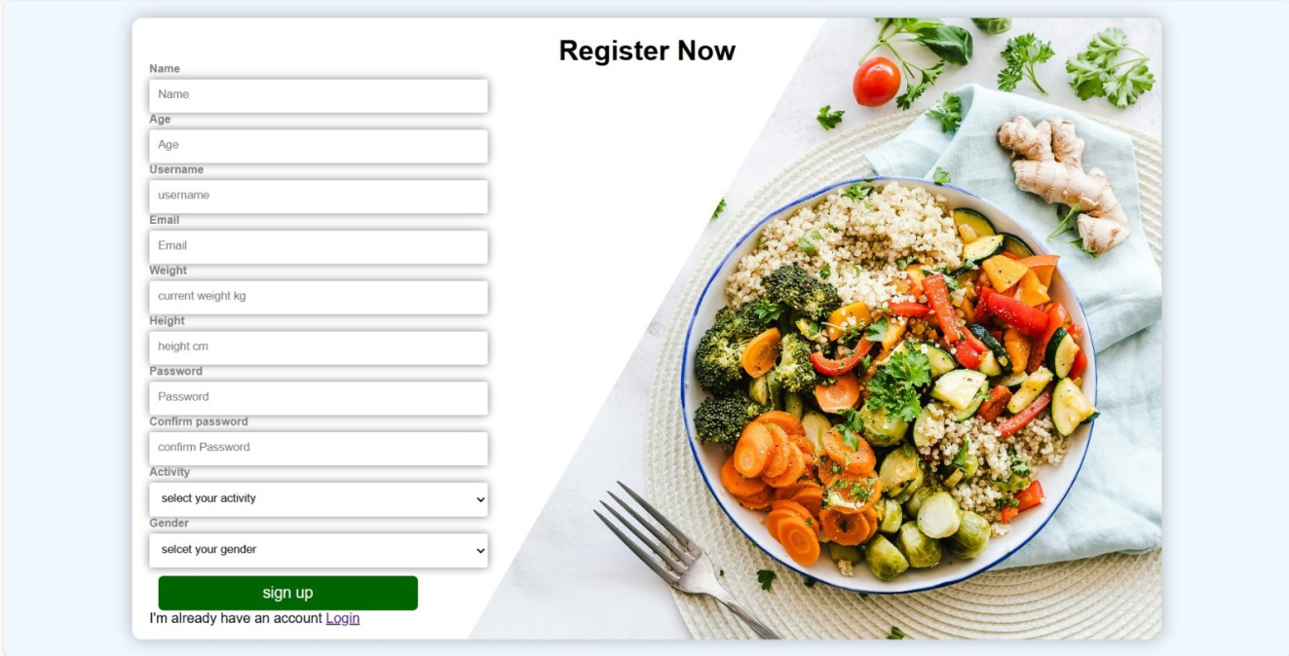
The registration page now allows new users to create an account by entering their username, email address, password, and other personal information
The user must register to access the site because he cannot access the site as a guest

Slide 15
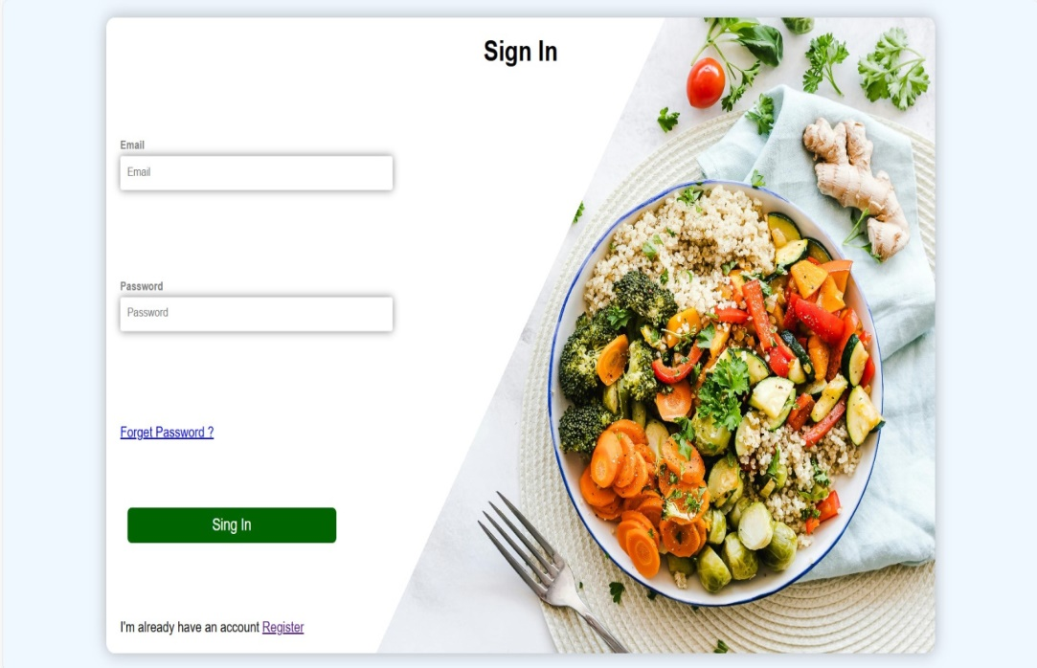
The login page allows users to access their accounts by entering their username or email address and password
Then we click on the login button to enter the site
This ensures quick and easy access to the website.

Slide 16
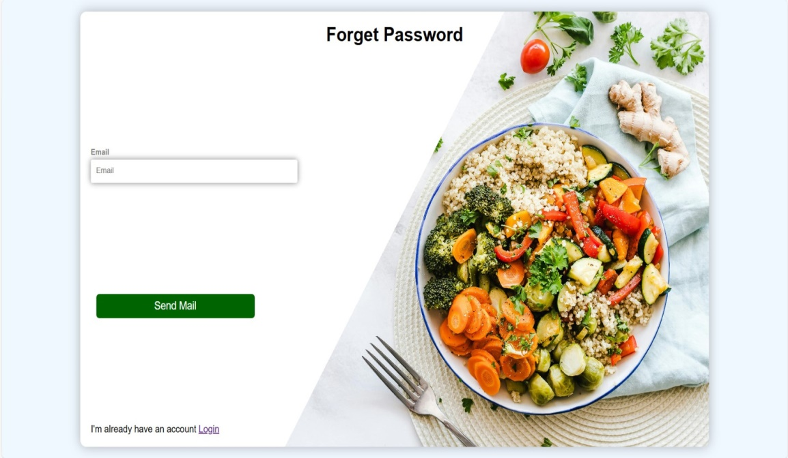
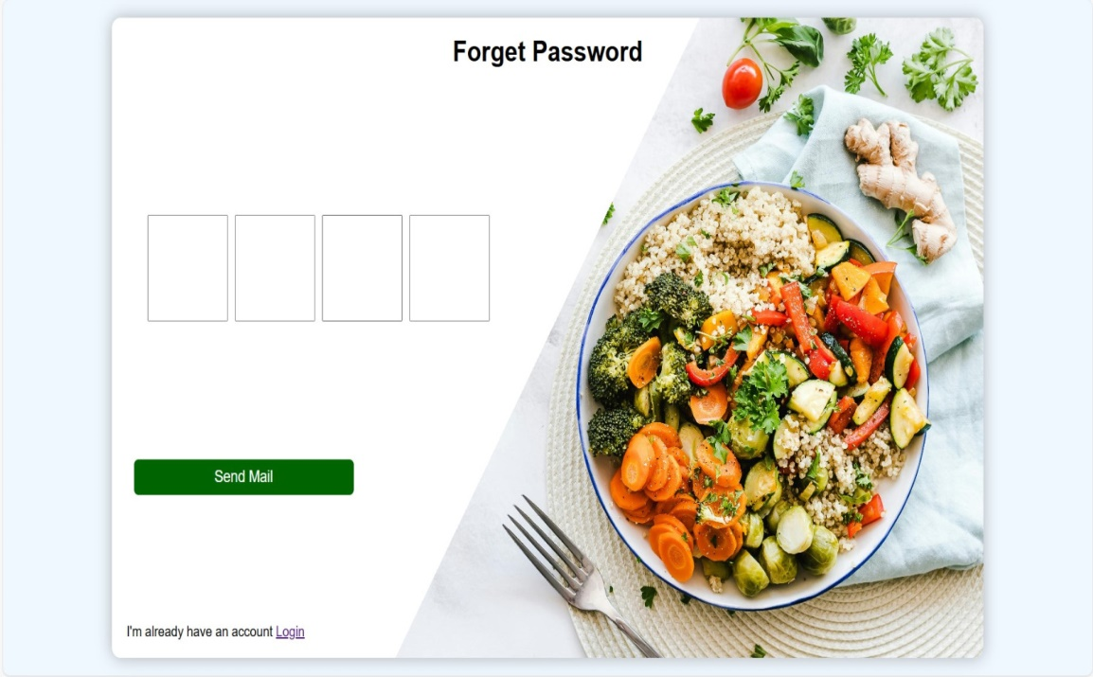
If you forget your password, you can reset your password via email only
Then you will receive a mail containing a four-digit code that you enter in the four boxes in front of you

Slide 17
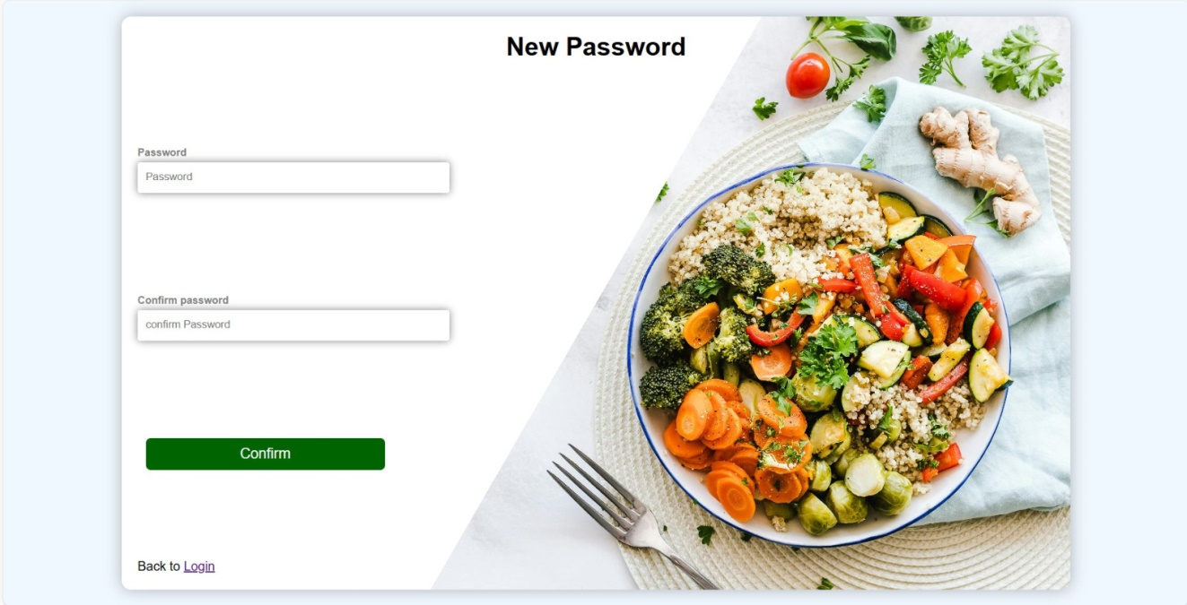
After you enter the code, you will reach this page to reset your password
Then you go to the home page

Slide 18
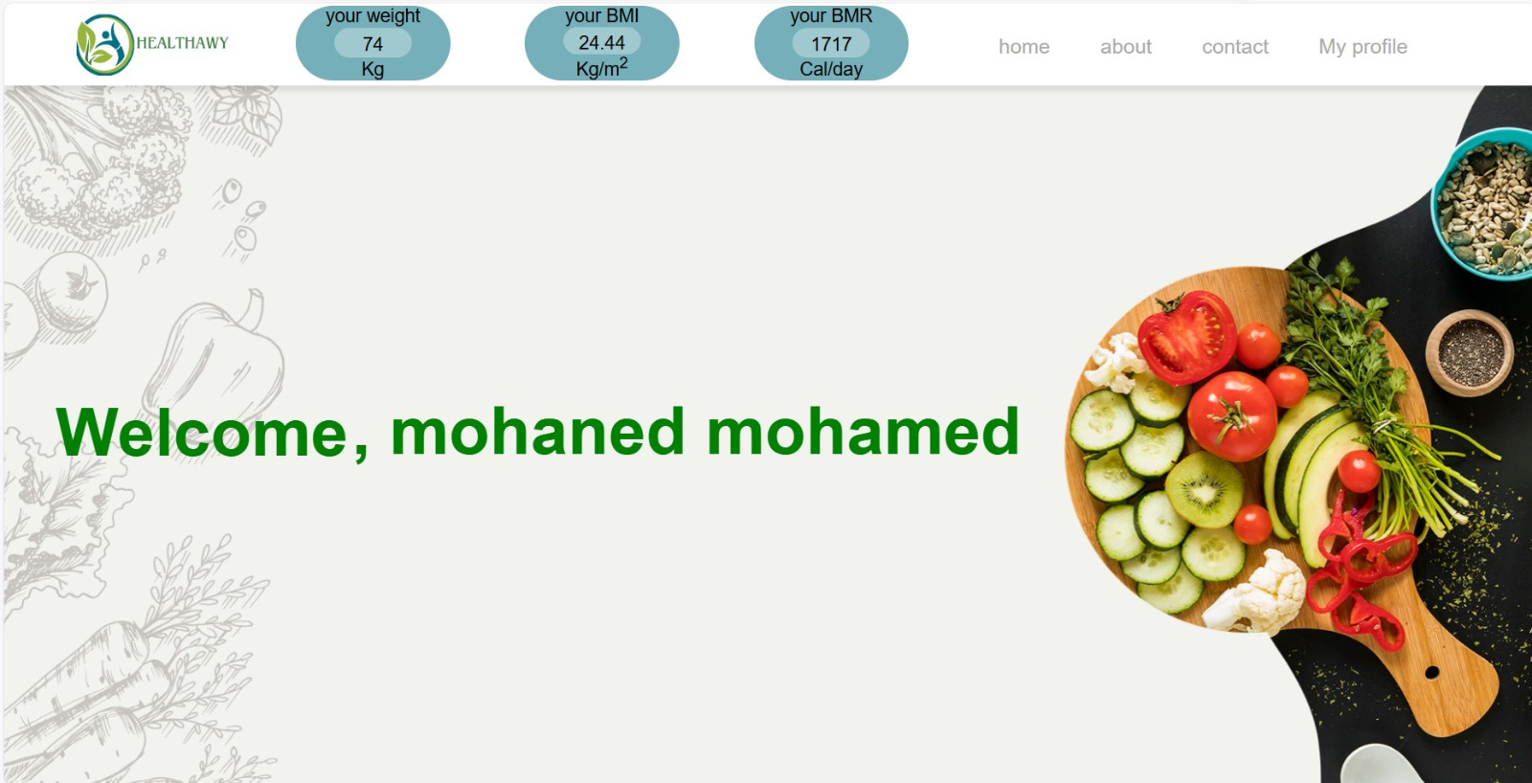
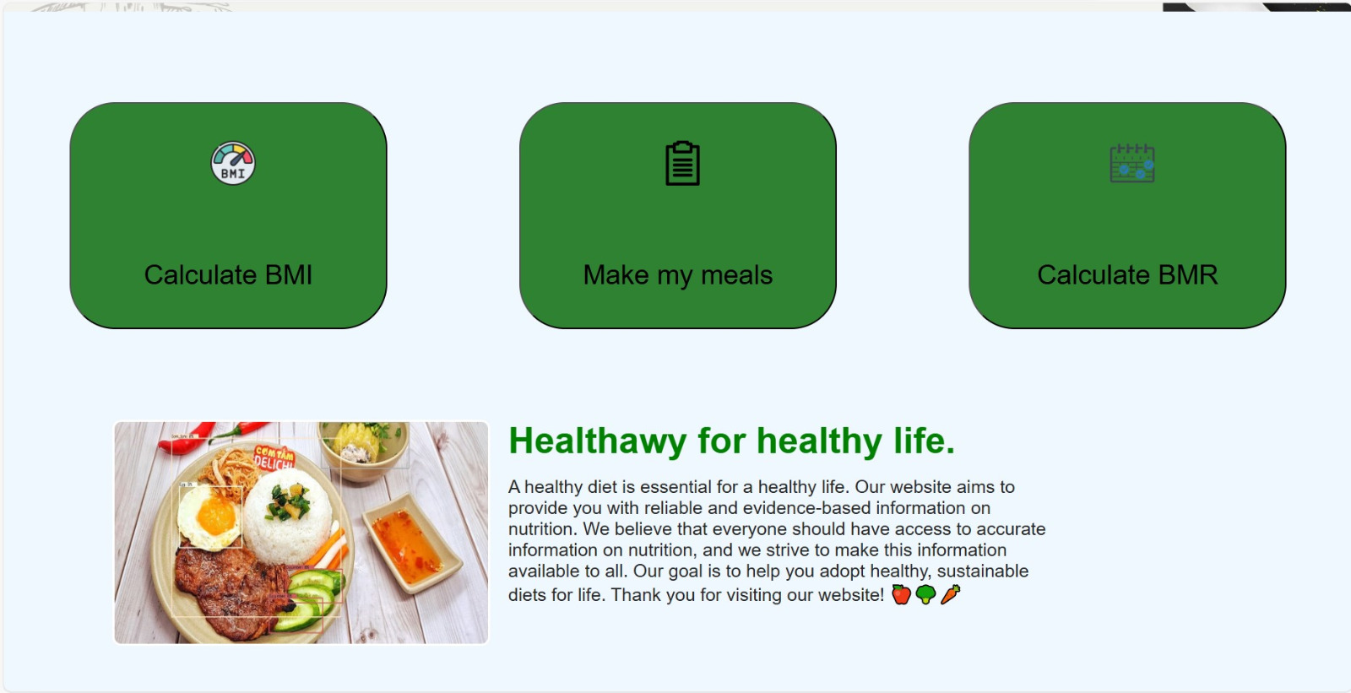
At the top we see the pages, body mass index, percentage of calories required per day, and weight
The home page contains 3 buttons in the middle
The first button sends us to the (BMI) page.
The second button sends us to the Make My Meals page.
The third button sends us to the (BMI) page.

Slide 19
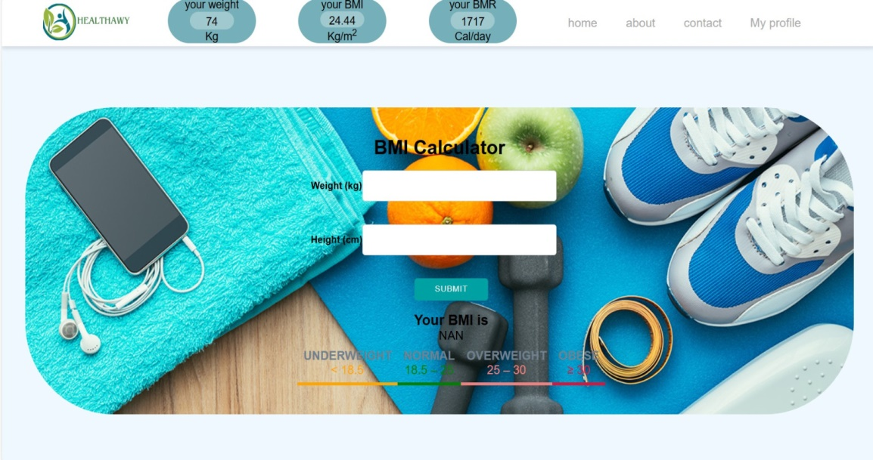
This page calculates your body mass index
If you want to calculate anyone else's body mass index

Slide 20
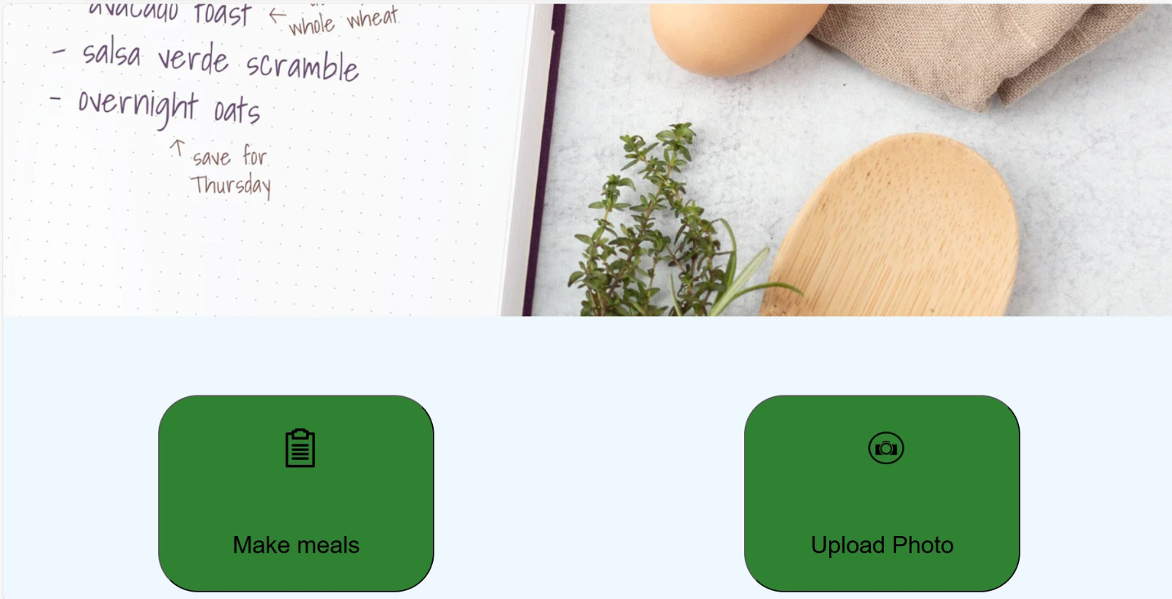
This page contains 2 buttons
The first button sends us to the page where we make the meal
The second button sends us to the page where we save meals
The rest of the page explains the importance of each meal

Slide 21
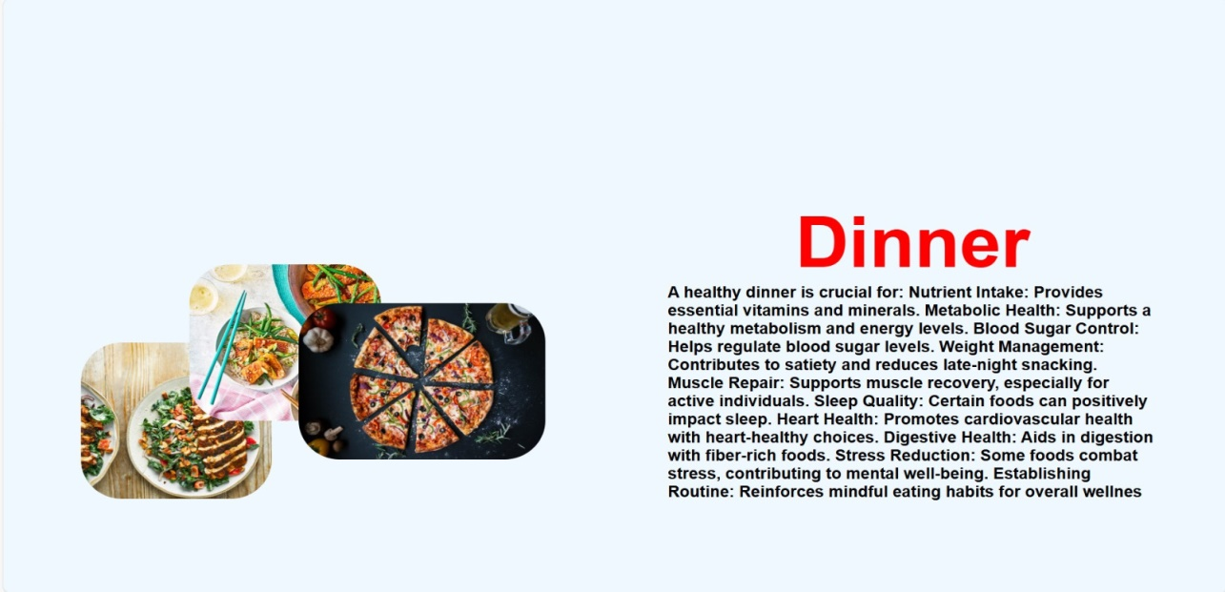
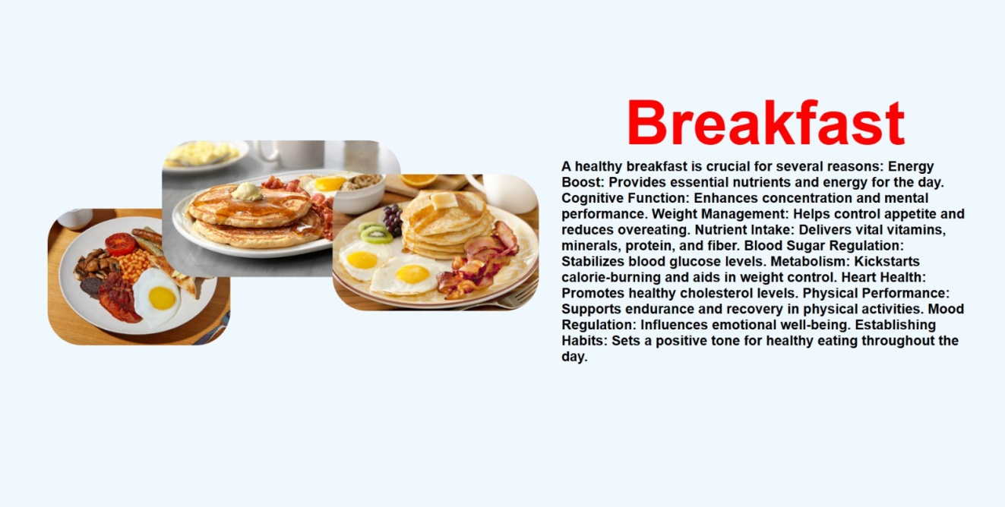
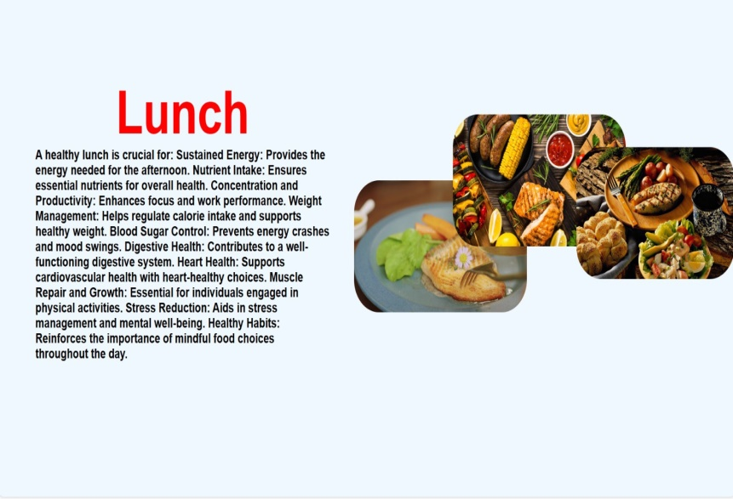

Slide 22
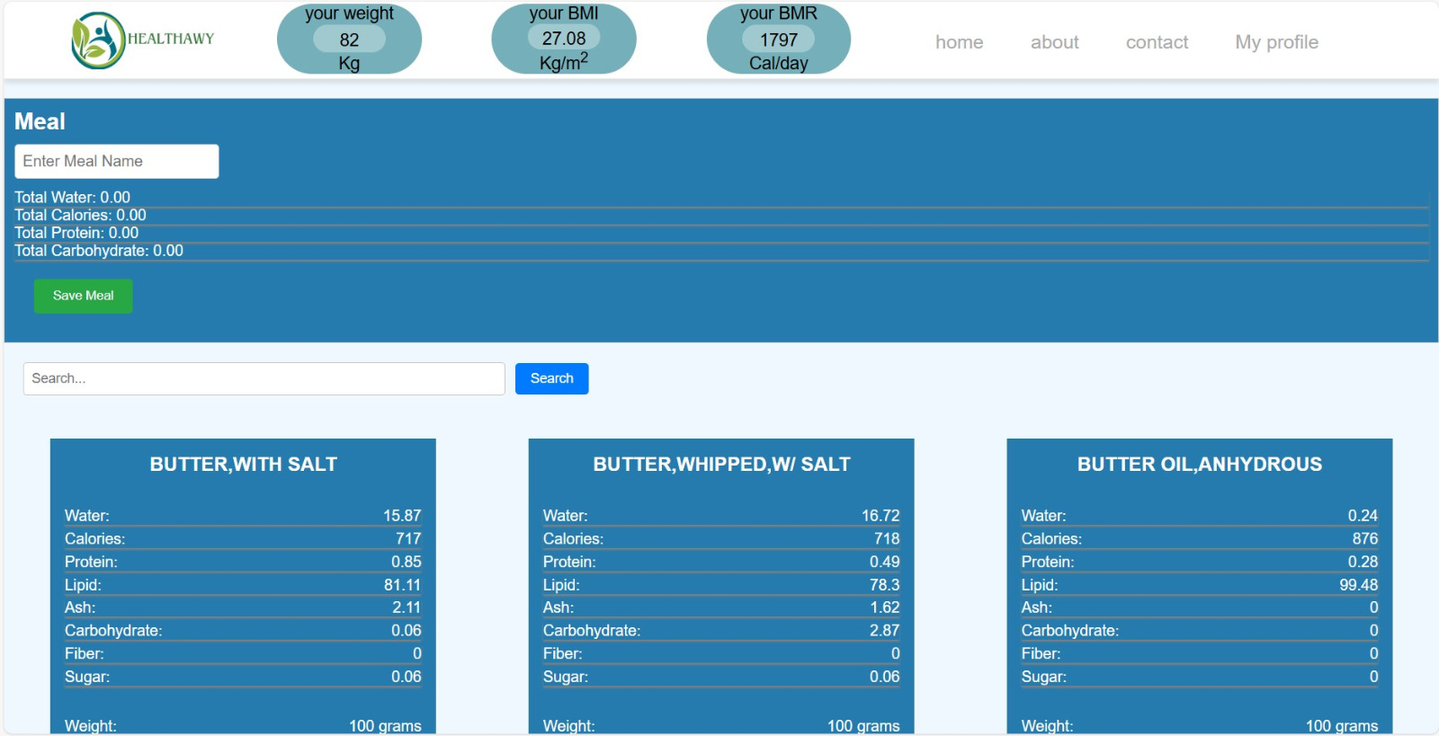
On this page, we prepare the meal we want according to its calories and the proportions of everything important in it, and there is a save button to save the meal if we want that.
We can also search about the ingredient we want

Slide 23
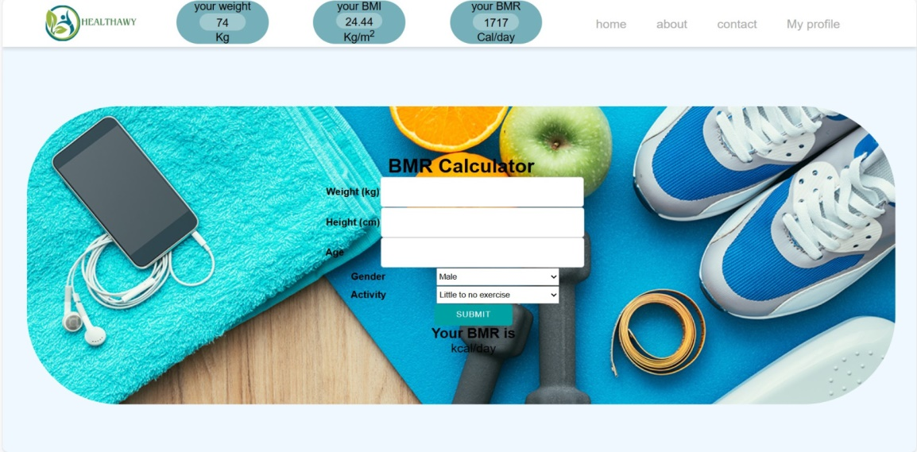
This page calculates the percentage of calories required daily
You can calculate anyone's calories

Slide 24
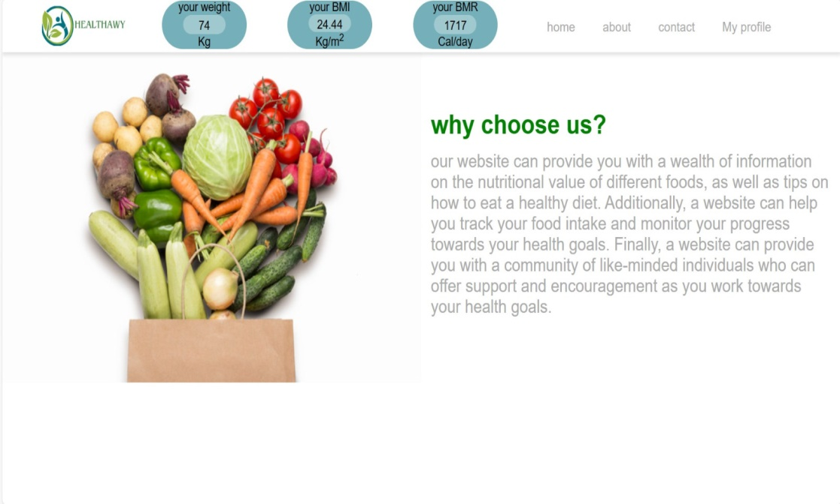
About us page , this page talks about the project and the team behind this project

Slide 25
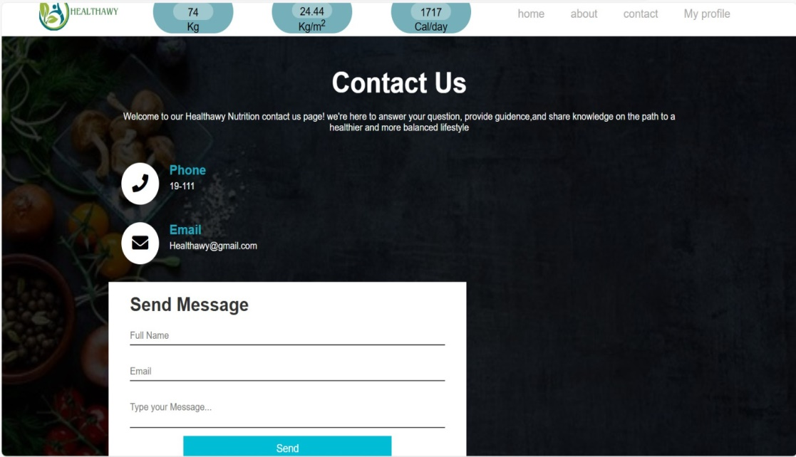
Contact us page here the user can get in touch with us for anu request or any issue

Slide 26
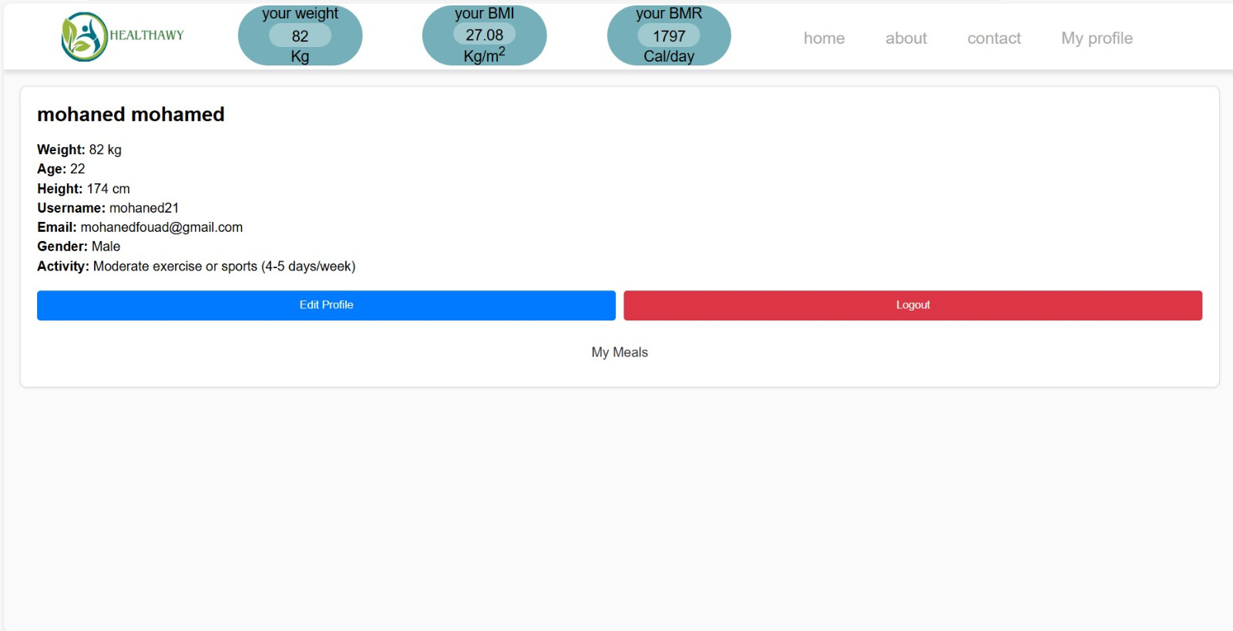
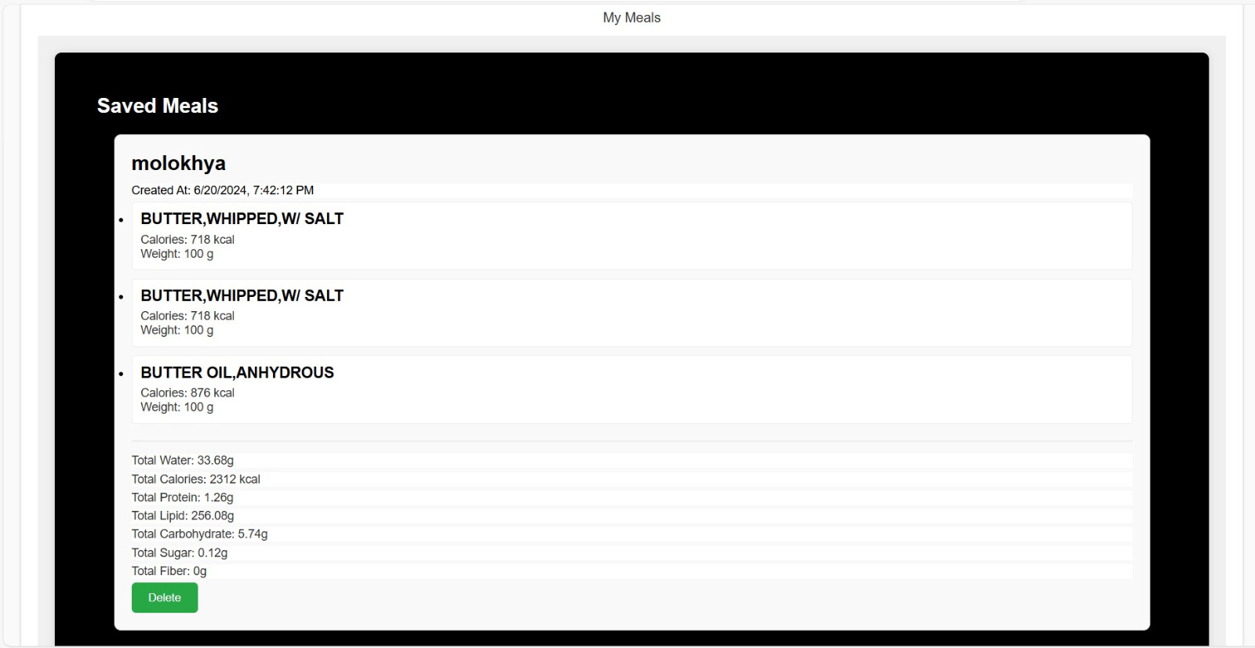
On this page we display user data
There is a button to modify data
And another button to log out of the site
When we click on my meals , the my meals page will show with the saved meals the user choosen

Slide 27
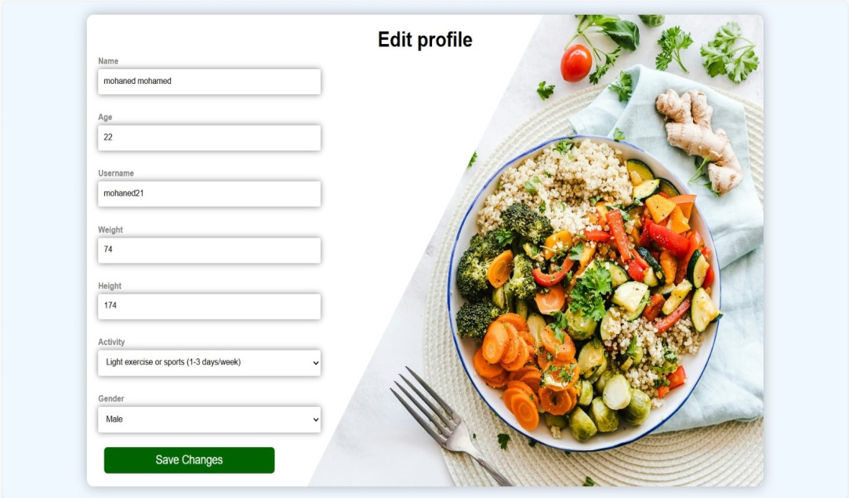
In this page , the user edits all his data

Slide 28
Source of data
In this project We used Multiple sources for Our data up to this point that might increase later to improve the model and our database
Kaggle: For more conventional datasets like the CVS dataset of the ingredients and their nutritional values
RoboFlow: For our image datasets with their labels and able to create our own Datasets of specific subjects with their labels.
Vegetables Test V3:
A dataset Containing Various Vegetables images from different angles and their labels cut into three parts the Training dataset containing 2787 Images and a Validation set containing 500 images and testing set of 148 images
Food Ingredients Recognition:
A dataset continuation with more ingredients from various angles and their label with three parts a training set of 11709 images and a validation set of 780 images and a test set of 522 images and their labels
Computer vision project:
A dataset continuation with more ingredients from various angles and their label with three parts a training set of 4524images and a validation set of 1287 images and a test set of 650images and their labels
Kaggle Dataset :
A Kaggle dataset containing The ingredients and meals with their nutritional values and their calories with great details.

Slide 29
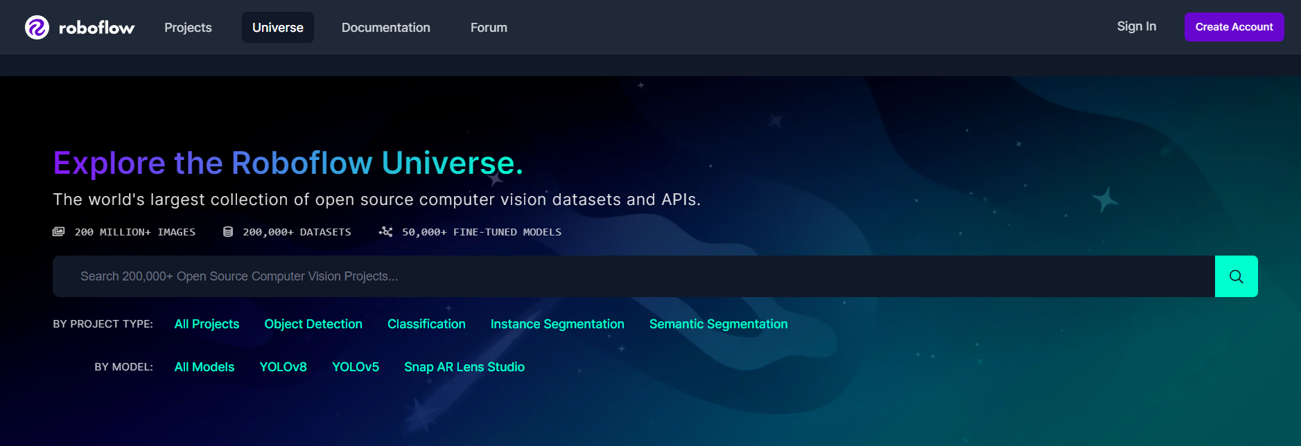
RoboFlow Universe.
Our dataset collection and cleaning was done using RoboFlow universe as it provides an easy and quick and efficient way to Create and get Datasets for specific cases with their labels using our model and mythdology.

Slide 30
YoloV5 (You Only Look Once)
Reasons we specifically used YoloV5 in our project:
High Precision: Excellent mean average precision (mAP), ensuring accurate detection and classification of objects.
Transfer Learning: Easily adapts to new tasks through transfer learning carrying over pre-trained weights, reducing the need for extensive data and training time.
Custom Training: Allows for custom object classes and datasets, making it suitable for specialized applications.
Multi-Scale Detection: Effectively detects objects of varying sizes within the same image.
User-Friendly: Simple and straightforward implementation with detailed documentation.
Pre-trained Models: Availability of pre-trained models that can be fine-tuned for specific tasks and objects
Compatibility: Compatible with popular frameworks like PyTorch, ensuring smooth integration into existing systems and improving upon.
In this project we used Yolo Version 5 as the model for multiple reasons
The ability to do transfer learning over multiple large datasets.
Fast and effective way to make custom datasets for specific cases.
Fast and Light way to use in a project to be used to real time image detection
One of the most accurate models for image detection and recognition

Slide 31
Data Collection :
The Pictures we chose for training came from Multiple datasets collected From RoboFlow universe pre-processed chosen from over hundreds of datasets.
the first dataset is -Vegetables_v3 Computer Vision Project Consisting of multiple vegetables classes from beet to tomato and potato for a total of 5000 images in this dataset alone.
The second dataset is - Food Ingredient Recognition Computer Vision
consisting of classes of food ingredients over a big variaity from onions to chicken pieces for a total of 5200 pictures in this dataset.
The third dataset to use for training is -TDL_final Computer Vision Project
consisting of classes of food ingredients with a wider variety having classes with fruits from grape to peach and orange consisting of 7660 images in the last dataset.

Slide 32
data pre-processing:
during the data pre-processing phase as roboflow and YoloV5 take the step with their ease of use to clean and check for issues in the huge amount of data we pre-processed it by deviding the data into 80% - 20% parts for training and testing respectivly for each datasets to training over each iteration of the model and improving the weights.

Slide 33
Data Augmentation:
for the training we also did some other steps to counter the lack of training data we saw in the roboflow and kaggle respectively by augmenting the data in multiple ways as in flipping the pictures and rotating it different degrees to improve the accuracy with each iteration.

Slide 34
Food classification using YoloV5:
The image classification model we used was YoloV5 which is a robust model known for its high accuracy.
each iteration of the model we trained to improve on was done carrying the weights of the pre-trained model before it and so on…
each iteration of the training was also done using the datasets we had chosen and found with 80% training partition over 5-10 layers to find the best training weights and the highest accuracy.

Slide 35
The databases we used throughout the project:
other than the datasets we used for training we opted to using NoSql datasets for keeping other types of data like the calories of the foods and their nutritional facts and The data of our users and admins as NoSql datasets provide security online with easy deployment and provides ease of use over horizontal data control for expansion over long time and collecting more data and offers the option to be integrated with other databases in any kind from Sql to other NoSql databases.

Slide 36
Detection Process
The user sends the photos they want to detect parts in as it goes to our trained model in the server
after the model runs on the image and detects all the ingredients in the image it sends it back in the form of an image showing the results of what each ingredient is and an array of the names of the objects it detected.
after we extract all the array of data and image we return it back to the front-end showing the client the image and using the array of data to show him the ingredients that was detected in the picture with their calories per 100gm to calculate the total calories and nutrients

Slide 37
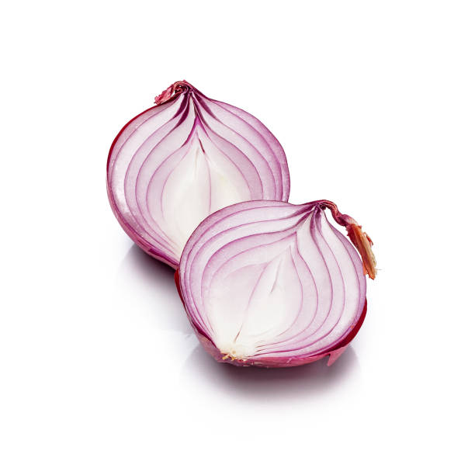
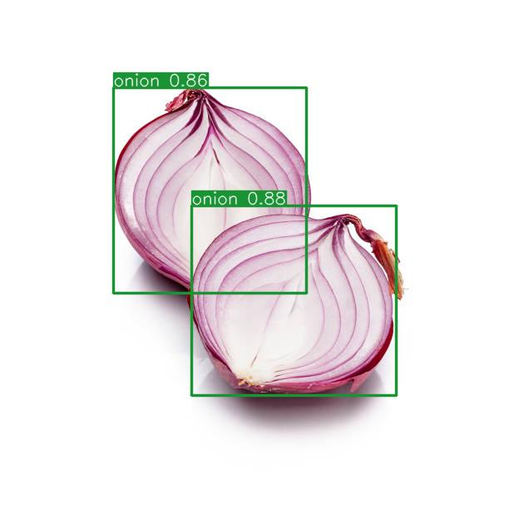
before and after using the model

Slide 38
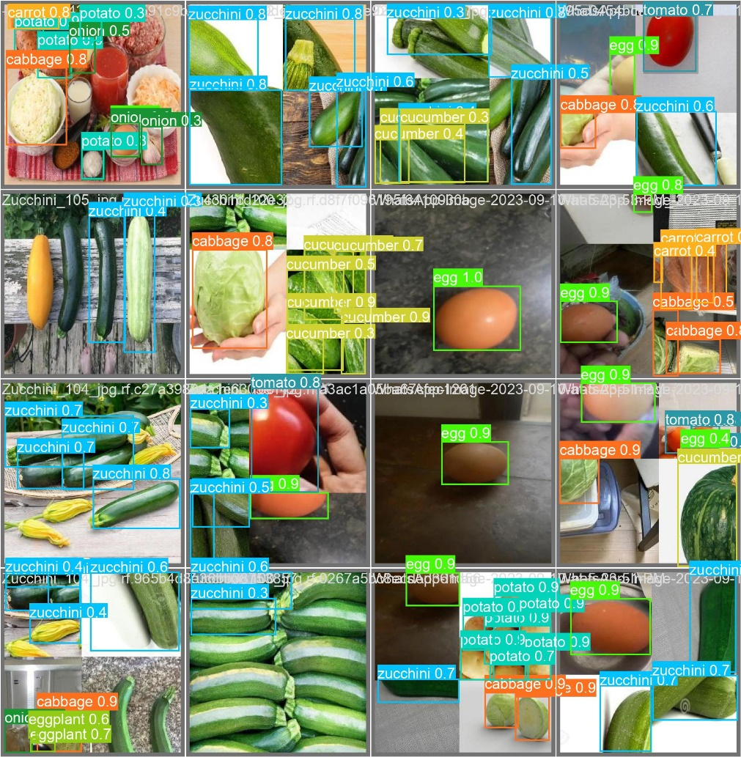
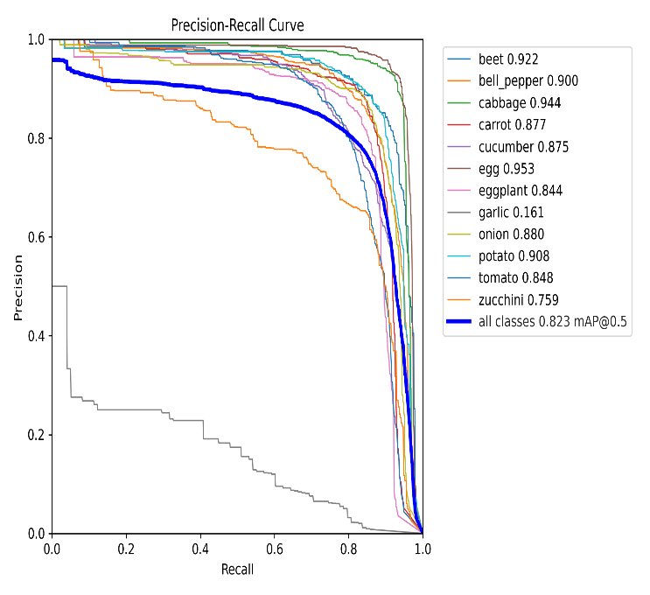
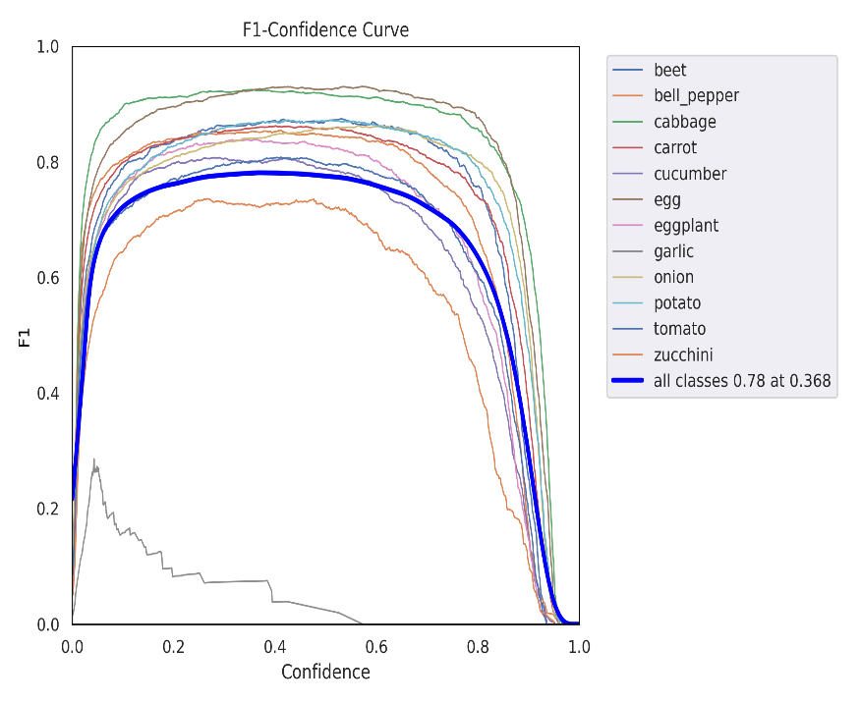
Model accuracy
Image processing
Precision-recall curve
F1-confidence curve

Slide 39
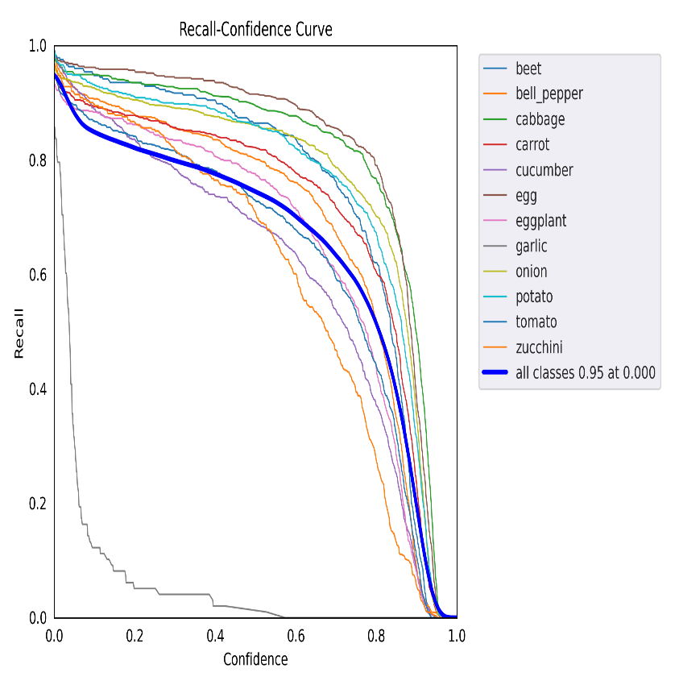
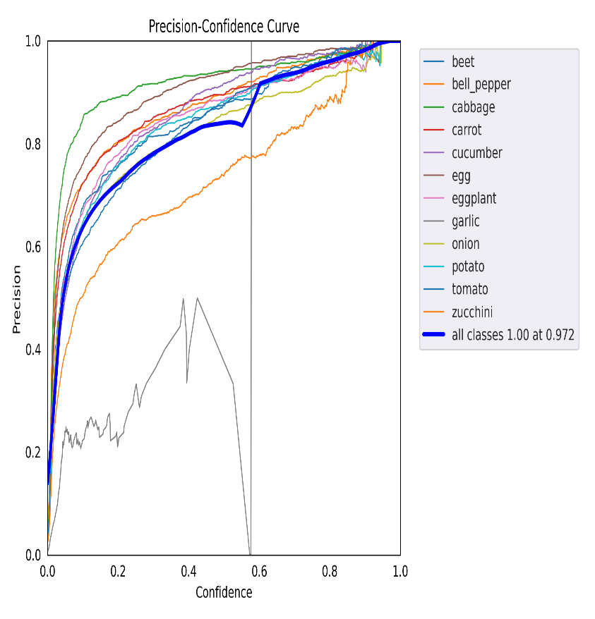
Model accuracy
Recall-Confidence Curve
Precision-confidence curve

Slide 40
Testing and maintenance:
Our project went successfully through multiple testing procedures to assure the quality and reliability:
Unit testing: each component of the project was carefully tested in isolation throught the production of the project to ensure functionality and performance.
integration testing: after we finished the unit tests for each component we conducted tests to evaluate the interactions between various component after integration together
system testing: Finally, after finishing all the tests before and finishing the project we carried out multiple system tests to assess the overall system's performance over multiple tasks from the client's processes and prespective.

Slide 41
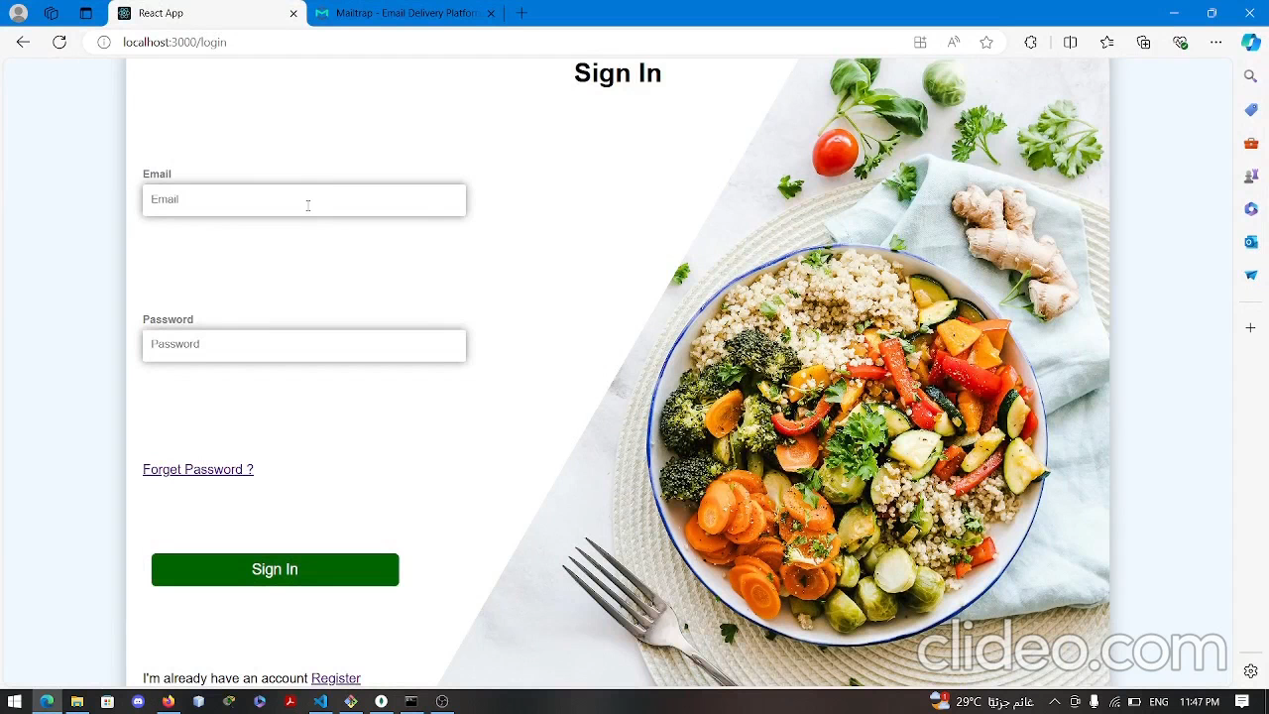
Demo

Slide 42

Conclusion
In conclusion, the last semester we focused on developing an optimal model for image detection, achieving a notable overall accuracy of 82% across all classes in our validation training. We also designed a mockup to enhance the front-end interface, aimed at improving user experience. Throughout the semester, we continuously refined our model, and we are pleased to report that our current accuracy is now within the range of 90%-91%. Moving forward, we plan to further improve our model by incorporating more datasets and making additional refinements. Our ongoing efforts are geared towards creating a highly accurate and user-friendly image detection system.

Slide 43
Future Work
For the chosen ingredients by the user the program will recommend meals on it
More regional food
Advanced Features
Mobile Application: Develop a dedicated mobile app to offer a seamless experience and offline access.
User-Generated Content: Encourage users to share their own recipes, success stories, and tips, fostering a sense of community and engagement.
Gamification: Introduce badges, challenges, and rewards to motivate users to achieve their health goals.

Slide 44
References
Ultralytics YoloV5 Documentation
RoboFlow Datasets:
Vegetables for image vision
Food Ingredients Recognition
Computer vision project:
Kaggle
ingredients

Slide 45


Thank You

